Slide 1
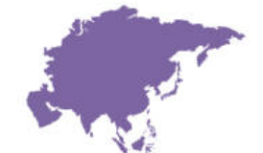
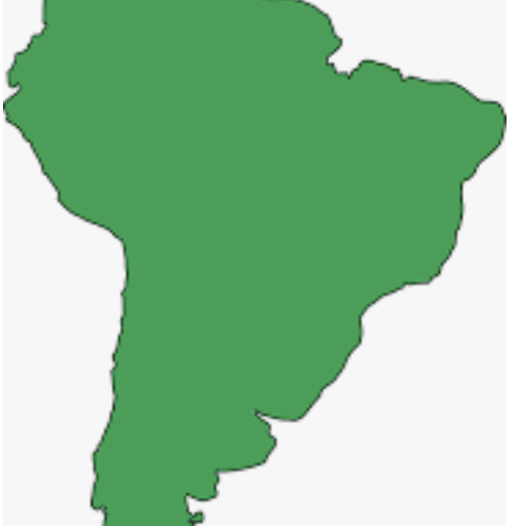

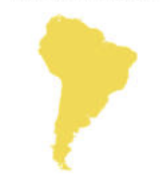
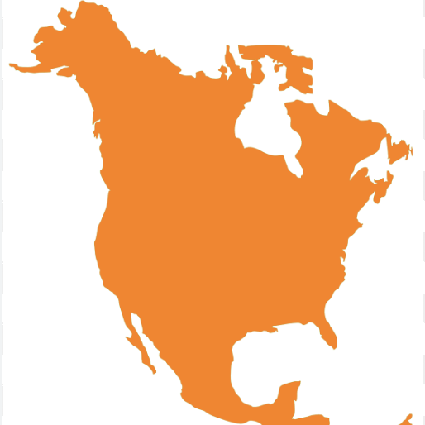

Change Yo Climate
A Continental Perspective

Slide 2
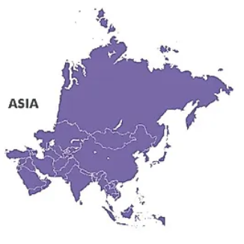
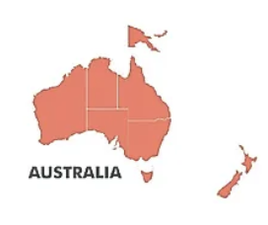
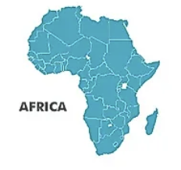
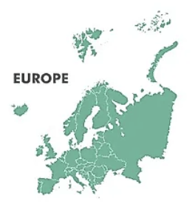
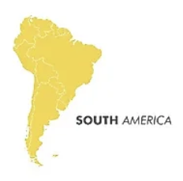
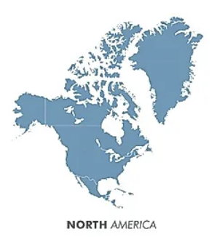
The aim of this project is to investigate the impacts of climate change around the world by analyzing historical data for six of the seven continental regions. Our analysis will focus on climate, water and forestry data accumulated during the 30 years between 1992 and 2021. It is our hope that with strong visualizations and an interactive website, we will present a strong case that compels users to make the necessary changes to decrease the rate of negative impact on the environment.
We are wondering if:
Will we be able to identify climate change related patterns for water, land and forestry by analyzing data at the Continent level.
Does climate change events on one Continent affect other Continents?

Slide 3
While there are still substantial sources of water in Africa, there are many challenges and opportunities to and for its management. As it relates to climate change impact, we considered extreme weather events and the resulting vulnerabilities.
Land use and availability has great agricultural potential due to the vast variety of natural resources, minerals, oil, and gas however, the impact climate change has greatly threatened the sustainability of life on the continent.
African forests are not only essential to life in Africa, but are a major contributor to the earth’s environment, climate regulation and the overall well-being of humanity.

Slide 4
64% of Asia is surrounded by water. This approximation includes not just the water surrounding the coastlines, but also Asia’s many islands, and peninsulas near bodies of water. As a matter of fact, Asia has one of the longest coastlines in the world.
With over 17.2 million square miles of land area, extreme weather events affecting land in Asia are varied. Like the other continents analyzed in this project, we focused on the extreme weather events that affected land in Asia.
Asian forests account for nearly 28% of the world’s total forest area. Due to the vast size of the Asian continent, there are many different types of forests within its regions, Siberian, tropical, temperate, and boreal.

Slide 5
Urbanization, agriculture expansion, climate changes and coastal development, mining, and natural resource extraction explain the increase in land use between 1992-2021. As the population grows, so must the food supply and water supply. Expansion of land use for agriculture required deforestation. The forests of Oceania represent 26% of its land area. Despite 100% of Oceania being surrounded by water, the region is negatively impacted by droughts which are caused by climate change.
Depending on location, the percentage of forestry in Oceania varies. For example, in Papua New Guinea, 70-75% of land are covered by forests. While forest areas in New Zealand is 31% and 17% in Australia. The combined governments of Oceania understand the significance of climate change and the negative affects climate change could have on its continent and border islands. Collectively they have implemented various programs and adopted practices to manage and mitigate climate change.

Slide 6
While avoiding redundancy, it is worth noting that similar factors increasing land use in Asia, North and South America and Oceania were at play in Europe. These common influences were urbanization, infrastructure development and agriculture. Europe’s efforts to address and minimize the effects of climate change by making investments in renewable energy sources also contributed to increased water, land and forestry uses.

Slide 7
Increased water demand in North America as depicted in the graph are the result industrial and municipal growth fueled by urbanization and economic growth. Municipal water demand for sanitation and drinking water purposes has increased water uses across all the countries on the continent. The agriculture demand for water to support increased crop production because of increased foreign and domestic populations.
Land use in North America increased during the 30 years between 1992-2021 because of urbanization and infrastructure development in response to population increases, agricultural expansion into forested areas, land degradation for agriculture, livestock grazing and waste management.
The impact of climate change can be observed by the changes in the North American forestry data and analysis. Deforestation caused by wildfires, pest infestations, urbanization and land development occurred during the periods between 1992 and 2021.

Slide 8
The effect climate has had on water use during the past 30 years in South America attributed to several factors, including hotter temperatures, changing rainfall patterns, sea-level rise, and intensified storms such as hurricanes.
Like its northern neighbor, South America experienced increased populations and urbanization because of investments in industrial development during the 30 years between 1992-2021. Water demand for cities affected by urbanization increased substantially. An expansion of the agricultural production of crops like soybeans and increased ranching and livestock also led to higher water consumption in South America.
Forests in South America accounts for 49%, nearly half the land area on the continent! Climate change has had significant impacts on the forests of South America.

